Slide 1

Neural Substrates of Attention and Awareness
Dan Birman
Gardner Lab
Frisem – 2015-04-17

Slide 4
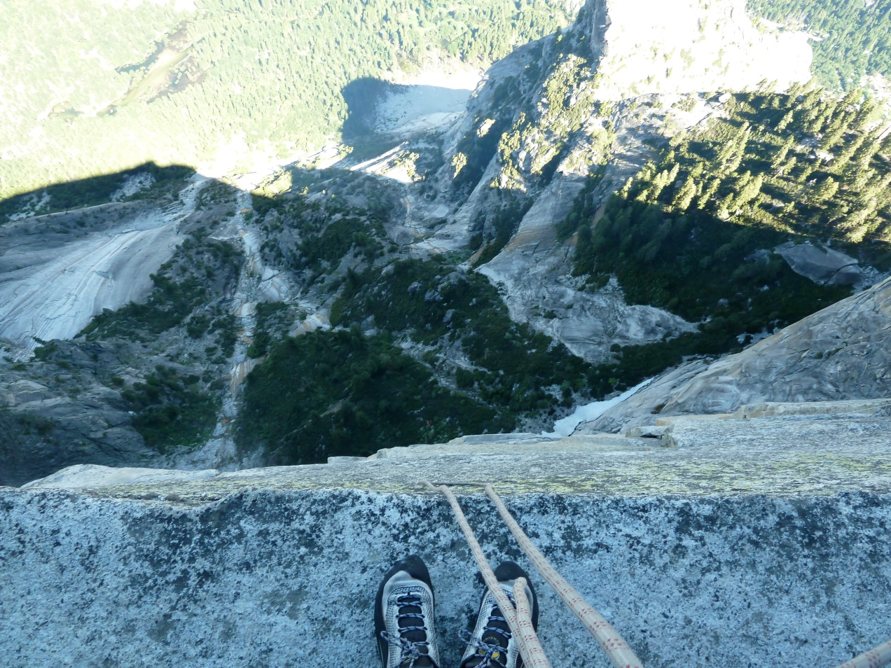

Slide 5
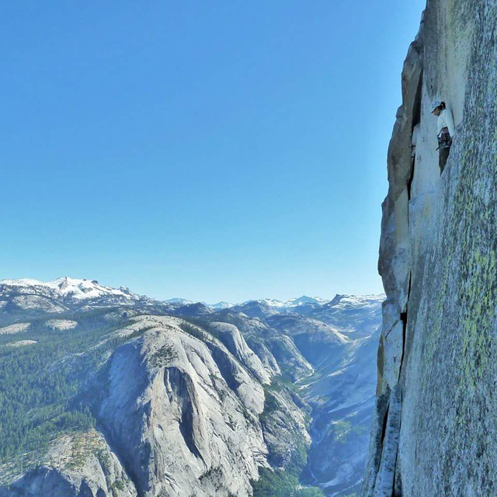

Slide 8
Neural Substrates of Attention and Awareness
Dan Birman
Gardner Lab
Frisem – 2015-04-17

Slide 11


Slide 12


Slide 13
Attention as a Pre-Requisite to Awareness
Dual task designs “pull” attention to one task, causing inattentional blindness for other stimuli.

Slide 14
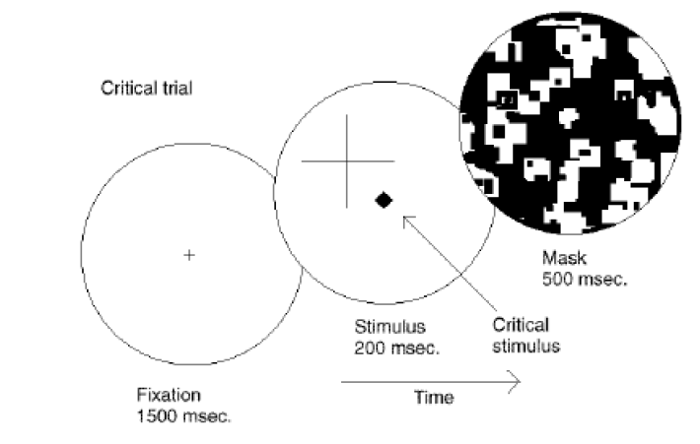
Attention as a Pre-Requisite to Awareness
Dual task designs “pull” attention to one task, causing inattentional blindness for other stimuli.
Mack & Rock, 1998
Notes:
There is one situation where attention (seems) to not be a pre-requisite for awareness

Slide 15
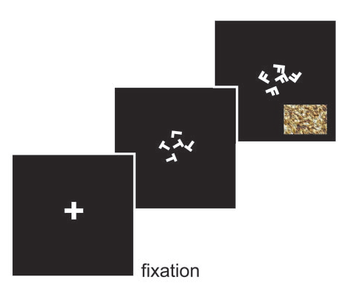
Gist Perception
Li et al., 2002

Slide 16
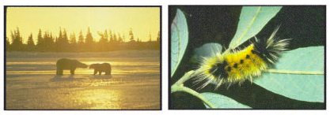
Gist Perception
Li et al., 2002

Slide 17
Gist Perception vs. Inattentional Blindness
“we believe […] there is no conscious perception without attention” (Mack & Rock, 1998)
“The close relationship between attention and
consciousness has led many scholars to conflate these processes“ (Koch & Tsuchiya, 2006)

Slide 18
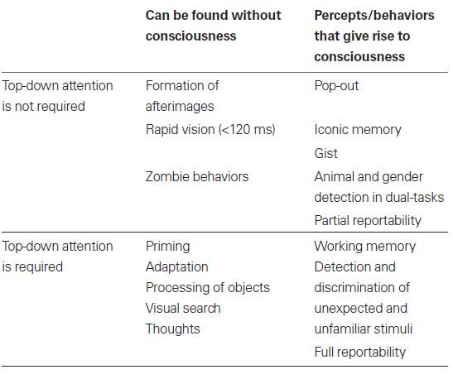
P
Perception of Stimulus:
Unaware
Aware
Unattended
Stimulus Is:
A
Attended

Slide 19
P
Perception of Stimulus:
Unaware
Aware
Unattended
Stimulus Is:
A
Attended

Slide 20
P
Perception of Stimulus:
Unaware
Aware
Unattended
Gist Perception
Stimulus Is:
A
Attended

Slide 21
P
Perception of Stimulus:
Unaware
Aware
Unattended
Inattentional
Blindness
Gist Perception
Stimulus Is:
A
Attended

Slide 22
P
Perception of Stimulus:
Unaware
Aware
Unattended
Inattentional
Blindness
Gist Perception
Stimulus Is:
A
Attended
Normal Vision

Slide 23
P
Perception of Stimulus:
Unaware
Aware
Unattended
Inattentional
Blindness
Gist Perception
Stimulus Is:
A
Attended
Continuous Flash
Suppression
Normal Vision

Slide 24
P
Perception of Stimulus:
Unaware
Aware
Unattended
Inattentional
Blindness
Gist Perception
Stimulus Is:
A
Attended
Normal Vision

Slide 25
P
Perception of Stimulus:
Unaware
Aware
Unattended
Inattentional
Blindness
Gist Perception
Stimulus Is:
A
Attended
Normal Vision
Trajectory Depends on
Interaction Between
Stimuli

Slide 28
Response Cued: 85%
Attend to Contrast
Respond about Contrast
Response Uncued: 15%
Attend to Contrast
Response about Motion Coherence

Slide 29
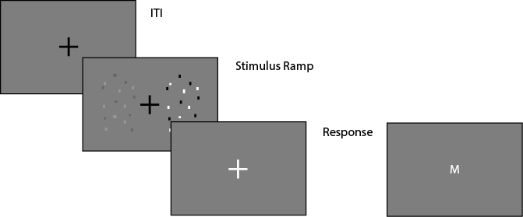
Task Design
Fixation: .4 - .8 s
Fixation
Stimulus Ramp: 1.4 s
Fixation
Response: 1.2 s (cued) / 3 s (catch)
Fixation

Slide 30
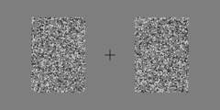
Task Design
Fixation
Stimulus Ramp: 1.4 s
Fixation
Response: 1.2 s (cued) / 3 s (catch)
Fixation

Slide 31
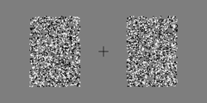
Task Design
Fixation
Stimulus Ramp: 1.4 s
Fixation
Response: 1.2 s (cued) / 3 s (catch)
Fixation

Slide 32
P
Perception of Stimulus:
Unaware
Aware
Unattended
Stimulus Is:
A
Attended

Slide 33
P
Perception of Stimulus:
Unaware
Aware
Response Uncued:
Coherence
(Unattended)
Stimulus Is:
A
Response Cued:
Contrast
(Attended)

Slide 34
P
Perception of Stimulus:
Perceptually Identical:
(Unaware)
Perceptually Distinct:
(Aware)
Response Uncued:
Coherence
(Unattended)
Stimulus Is:
A
Response Cued:
Contrast
(Attended)

Slide 35
P
Perception of Stimulus:
Perceptually Identical:
(Unaware)
Perceptually Distinct:
(Aware)
Response Uncued:
Coherence
(Unattended)
Stimulus Is:
A
Response Cued:
Contrast
(Attended)

Slide 36
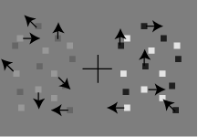
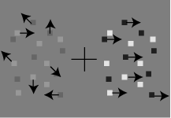
P
Perception of Stimulus:
Perceptually Identical:
(Unaware)
Perceptually Distinct:
(Aware)
Response Uncued:
Coherence
(Unattended)
Stimulus Is:
A
Response Cued:
Contrast
(Attended)

Slide 37
Discrimination of Contrast
Attend to
Contrast
Effect On
Discrimination of Motion
Coherence

Slide 38

Mack & Rock
Attention is
Required for Awareness
Discrimination of Contrast
Attend to
Contrast
Effect On
Discrimination of Motion
Coherence

Slide 39

Mack & Rock
Attention is
Required for Awareness
Discrimination of Contrast
Attend to
Contrast
Effect On
Discrimination of Motion
Coherence
Attention and
Awareness are Distinct
Koch & Tsuchiya

Slide 40
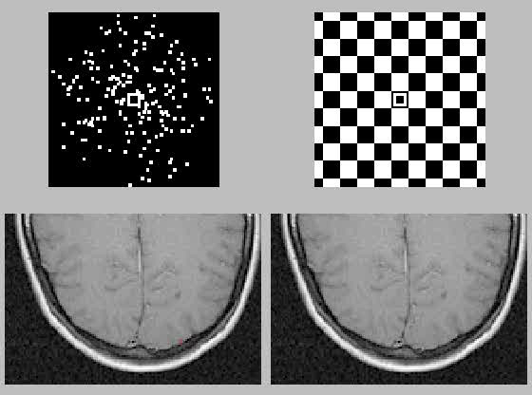
http://www.cns.nyu.edu/~david/courses/perception/lecturenotes/motion/motion.html

Slide 41
Attend to:
Contrast
Coherence
Discrimination of Contrast
Effect On
Discrimination of Motion
Coherence
Sensory Enhancement
of Contrast may
Feed Forward to MT

Slide 42
Sensory Enhancement
of Coherence is unlikely
to Feed Back to V1
Attend to:
Contrast
Coherence
Discrimination of Contrast
Effect On
Discrimination of Motion
Coherence

Slide 43
cue: constrant -> respond: coherence WORKS / NOT in each of the mack/rock, koch/tsuchiya, neural substrate hypothesis

Slide 44
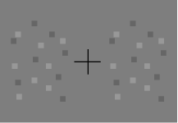
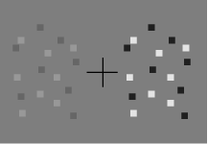
A Proxy for Awareness

Slide 45
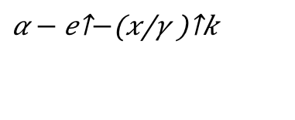
A Proxy for Awareness
Maximum Likelihood Fit:
Weibull Function
$$α − e^{−{\left(\frac{x}{γ}\right)}^{k}}$$

Slide 46
A Proxy for Awareness
Maximum Likelihood Fit:
Weibull Function
$$α − e^{−{\left(\frac{x}{γ}\right)}^{k}}$$

Slide 47
A Proxy for Awareness

Slide 48
A Proxy for Awareness

Slide 49
A Proxy for Awareness
Easier: Less Difference
Same Performance
What is the effect of cueing?

Slide 50
Effect of Cueing Coherence on Contrast
Easier: Less Difference
Same Performance

Slide 51
Effect of Attention

Slide 52
Effect of Attention

Slide 53
Effect of Attention

Slide 55
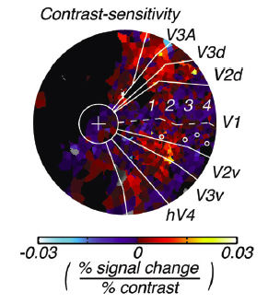
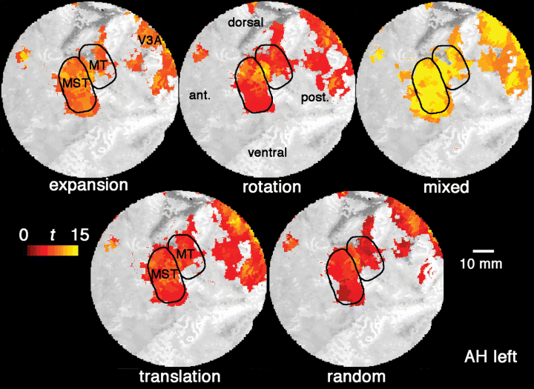
Attend to:
Contrast
Coherence
Discrimination of Contrast
Effect On
Discrimination of Motion
Coherence
Sensory Enhancement
of Contrast may
Feed Forward to MT

Slide 56
Sensory Enhancement
of Coherence is unlikely
to Feed Back to V1
Attend to:
Contrast
Coherence
Discrimination of Contrast
Effect On
Discrimination of Motion
Coherence

Slide 58
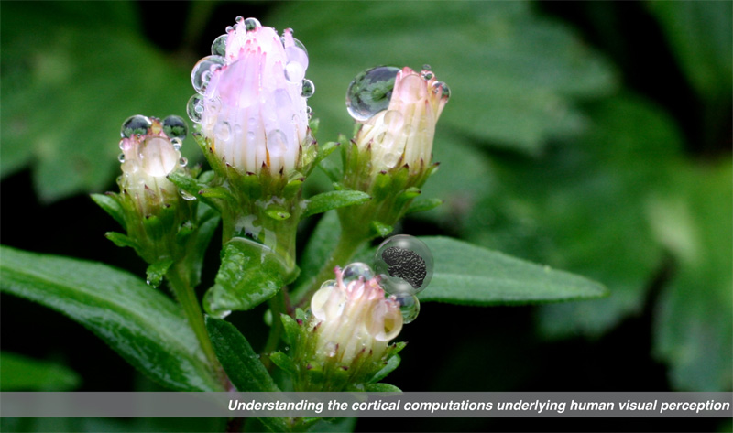

Gardner Lab @ Stanford University
Thank You!
Justin Gardner
Steeve Laquitaine
1st Year Cohort

Slide 59
add a slide where you do
cue: constrant -> respond: coherence WORKS / NOT in each of the mack/rock, koch/tsuchiya, neural substrate hypothesis
here we do care about the thresolds: need ~30-50 trials, for the slopes we need ~300 trials

Slide 60
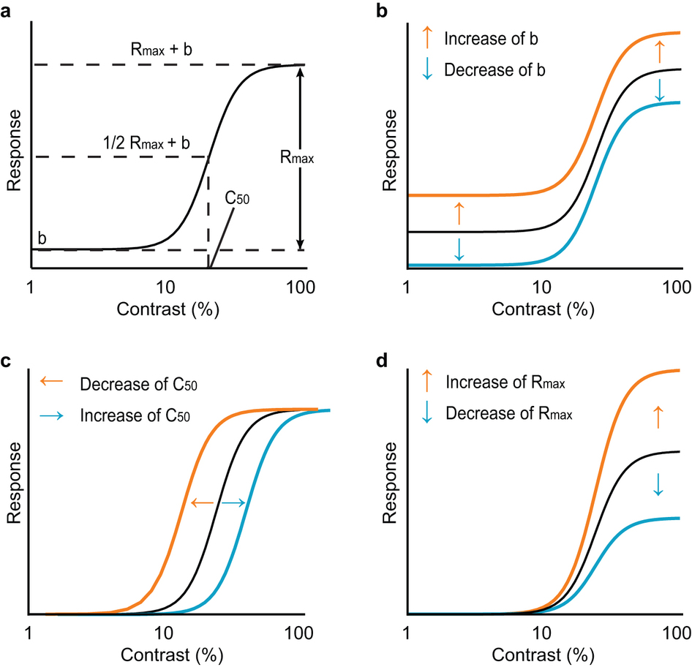
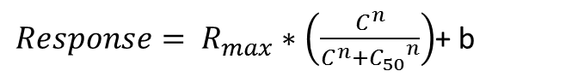
$Response= R_{max}∗\left(\frac{C^{n}}{C^{n}+{C_{50}}^{n}}\right)$+ b
Baseline Shift
Response Gain
Contrast Gain
Soma et al. 2013

Slide 61
Behavior in the Scanner
Outside
Inside Scanner

